Slide 1
Java 4 WEB
Lesson 1 – Home tasks overview

Slide 2

1. Missed library for testing or unused libs
jcommander-1.72.jar
ant-1.7.0.jar
ant-launcher-1.7.0.jar
aopalliance-1.0.jar
bsh-2.0b4.jar
guava-16.0.1.jar
guice-4.0.jar
hamcrest-core-1.1.jar
javax.inject-1.jar
jcommander-1.48.jar
junit-4.10.jar
snakeyaml-1.15.jar
Notes:
Add all libs to git index and commit and push while we do not use build tools like Gradle or Maven
Do not add unused libraries, it makes program slower and more memory consuming

Slide 3

2. Modified test cases (commented)
Notes:
Student should not disable test cases
Student should not recommit tests

Slide 4
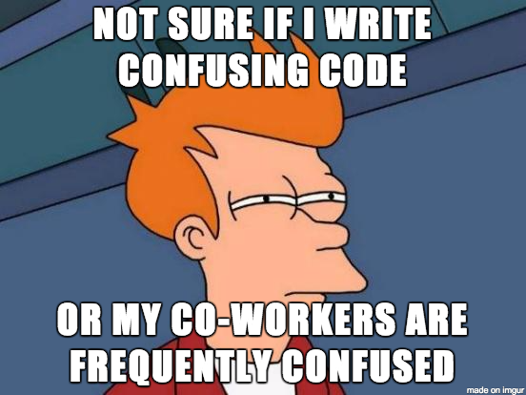
3. Too complex methods

Slide 5
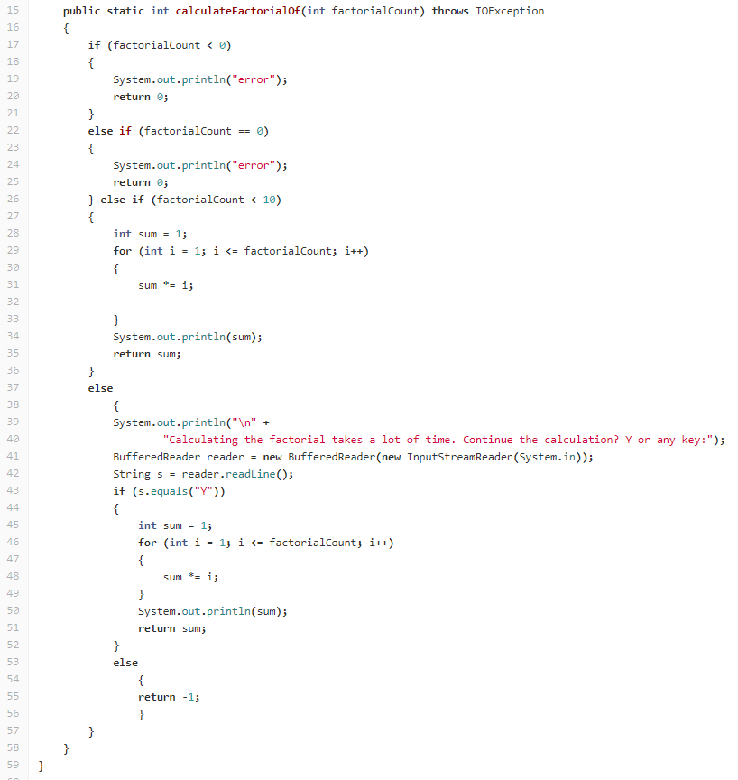
3. Too complex methods
Notes:
Very long due to not single responsibility:
Extract output
Extract input
Extract decision logic

Slide 6
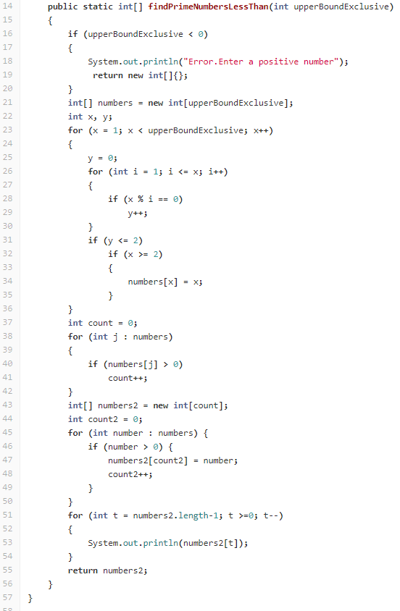
3. Too complex methods
Notes:
Very long due to not single responsibility:
Extract out
Extract isPrime
Extract arrays copy

Slide 7
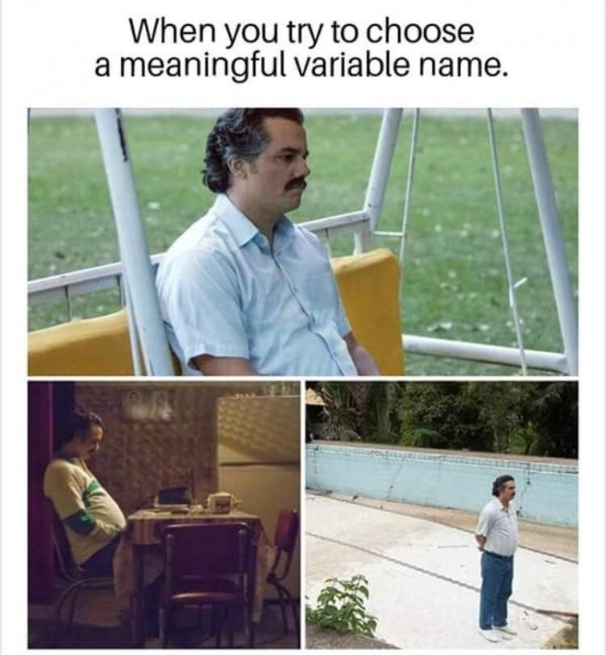
4. Naming
zz
array
anArray
anAnArray
tst
count
count2
s
Notes:
Use meaningful naming

Slide 8
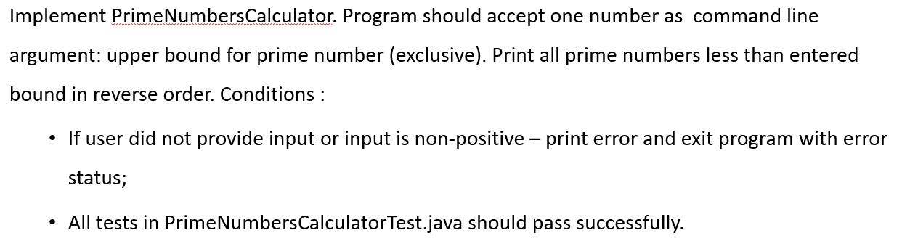
5. Not clear understanding of task

Slide 9
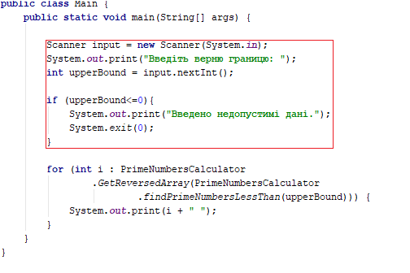
5. Not clear understanding of task
Notes:
All parameters should be passed from command line

Slide 10
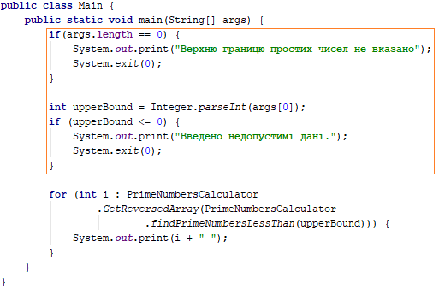
5. Not clear understanding of task
Notes:
Fixed parameters should be passed from command line
Wrong messages

Slide 11
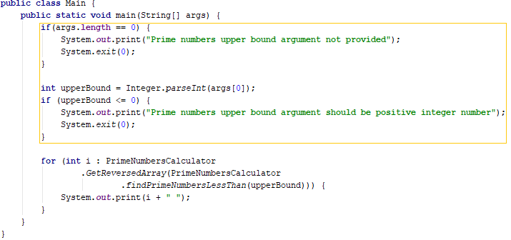
5. Not clear understanding of task
Notes:
Fixed messages
Wrong exit status code

Slide 12
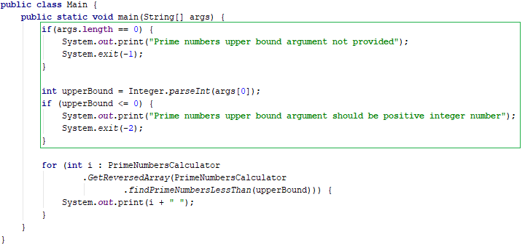
5. Not clear understanding of task
Notes:
Method can be extracted (optional)

Slide 13
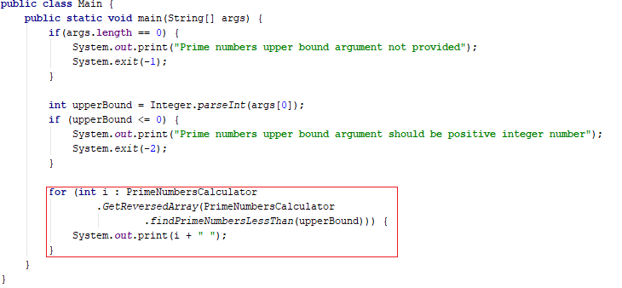
6. Follow single responsibility principle

Slide 14
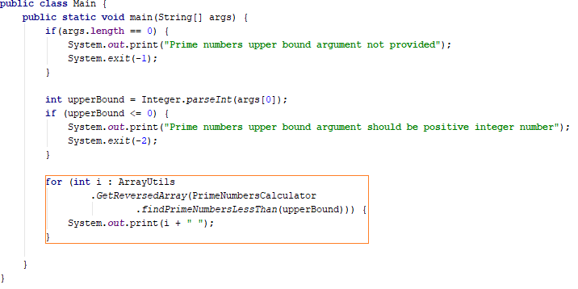
6. Follow single responsibility principle

Slide 15
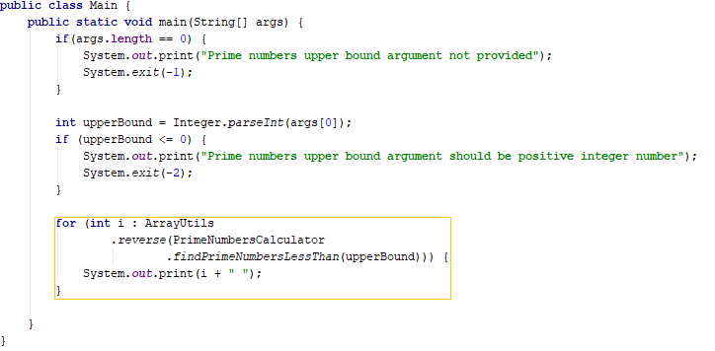
6. Follow single responsibility principle
Notes:
Follow naming convention

Slide 16
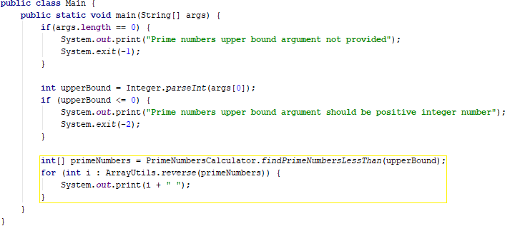
6. Follow single responsibility principle
Notes:
Follow naming convention

Slide 17
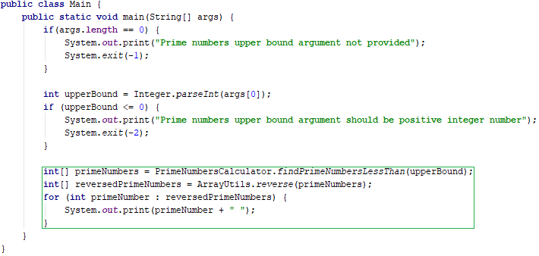
6. Follow single responsibility principle
Notes:
Follow naming convention

Slide 18
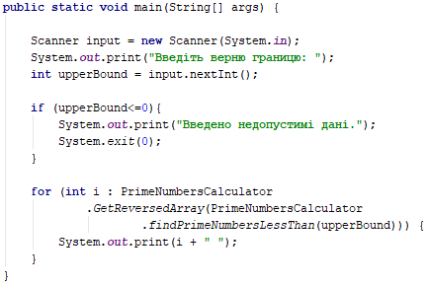
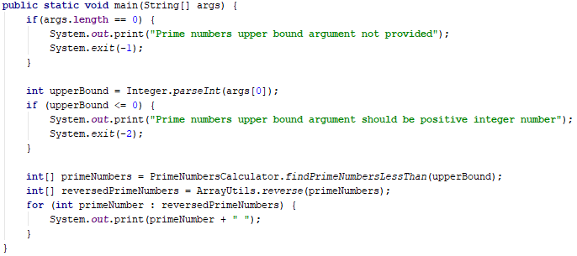
6. Follow single responsibility principle
Notes:
Follow naming convention

Slide 19
7. Bad commit messages
Sorry
L01-T1, L01-T3
Try to initialize array[-5,new int[0]]
Commit
my first commit
java.lang.NegativeArraySizeException: -5
Delete Main.java
Загрузить новый файл
/* #######################################...
Delete PrimeNumbersCalculatorTest.java
first commit.
L01-T2 "factorialCount 0 = 1“
L01-T3 "Created classes, implement unit tests“
removed unused imports in tests
add testng-6.9.9 library
L01 Library for programs
L01-T3 Main code for program MatrixUtils , some time later L01-T3 Code for program MatrixUtils
L01-T1 Implement unit tests for program FactorialCalculator
IC-2018.2.4 <Jake@MacBook-Air-Apple.local Delete jdk.table.xml, IU-2018.2.4 <admin@DESKTOP-GJ39N5M Update vcs.xml
L01-T0 Fix for normal commits
L01 Errors.java: changed message format
Update .gitignore
Upload New File
Add new directory
L01-T3 Code review
L01-T3 #3 fixed: MatrixUtilsTest - remove unused imports -- removed import org.geekhub.lesson1.task3.MatrixUtils; Format code -- formatted via Ctrl+Alt+L Specify testng version -- TestNG is v6.8.8 Main::main - Method is too complex. Simplify by extracting private sub-methods with descriptive naming. Good method size is about 5-10 lines -- is decomposited method to 2 private sub-method
Notes:
When commit is not related to single task (like `remove idea folder` specify only lesson #)
Good commit message is 5-10 words (no exclusions

Slide 20
8. Do not commit IDE specific files
Do not remove *.iml or .idea from gitignore

Slide 21
9. Do not modify repository manually
Do not make any changes in repo from gitlab.com web-view from your browser

Slide 22
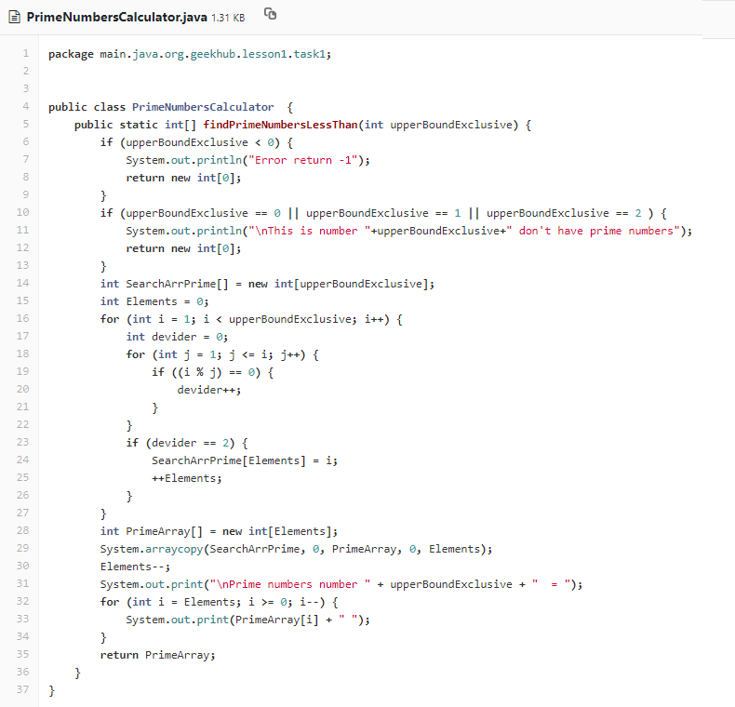
10. Find two differences (1)
Student 1

Slide 23
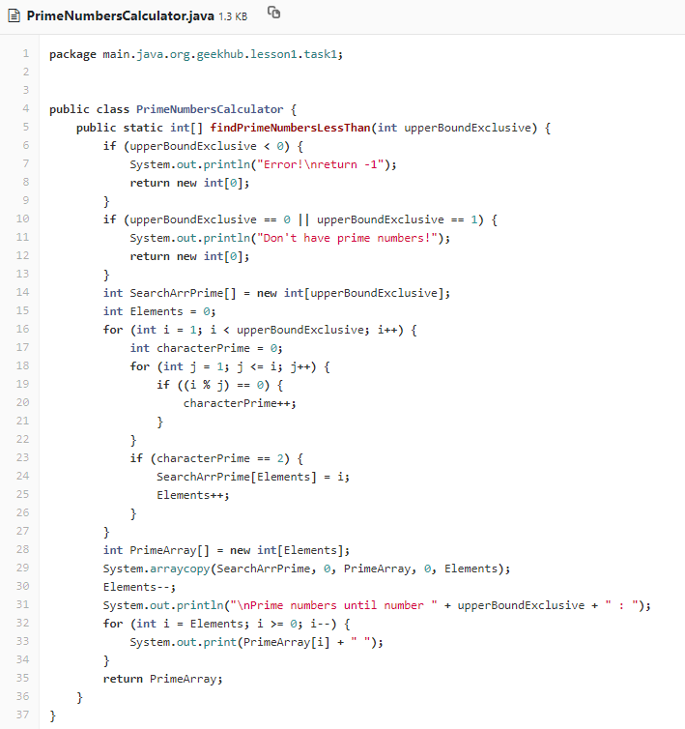
10. Find two differences (1)
Student 2

Slide 24
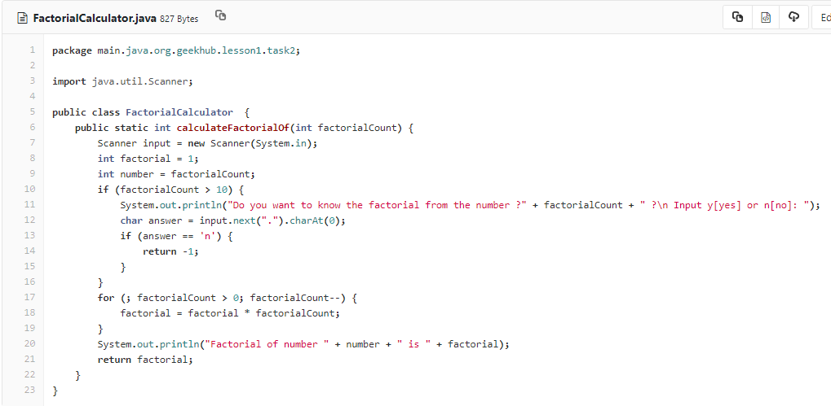
10. Find two differences (2)
Student 1

Slide 25
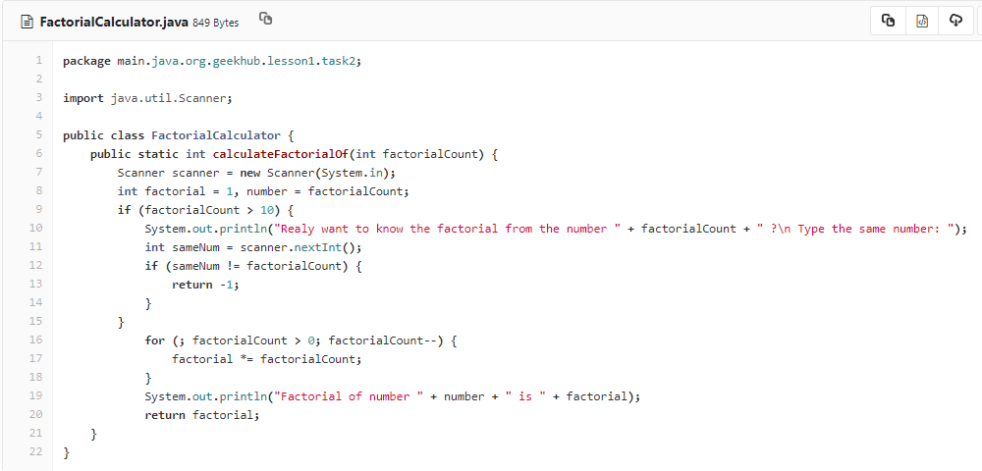
10. Find two differences (2)
Student 2

Slide 26
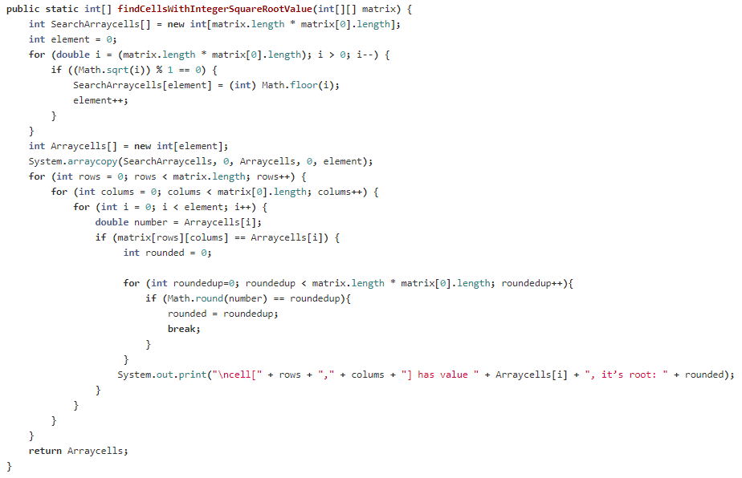
10. Find two differences (3)
Student 1

Slide 27
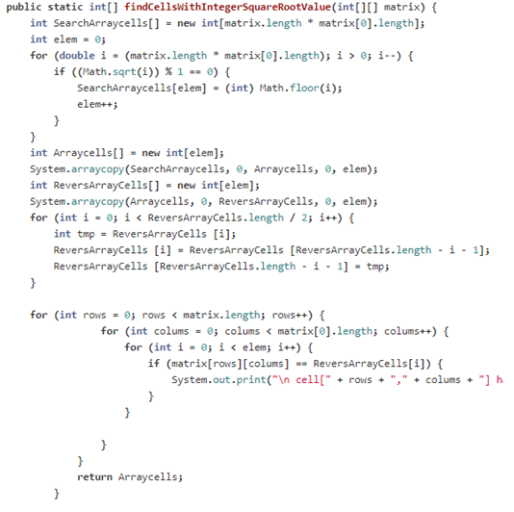
10. Find two differences (3)
Student 2

Slide 28

10. Find two differences

Slide 29

Homework
Fix all issues created in your repo
All fixes should be pushed not later than 3 (three) days after today
Follow recommendations from https://docs.google.com/document/d/1Hpq1pwbsTWtCbNcq-nlFEcHqXhRdfdQ4txyaPMrVJJU

